Slide 1

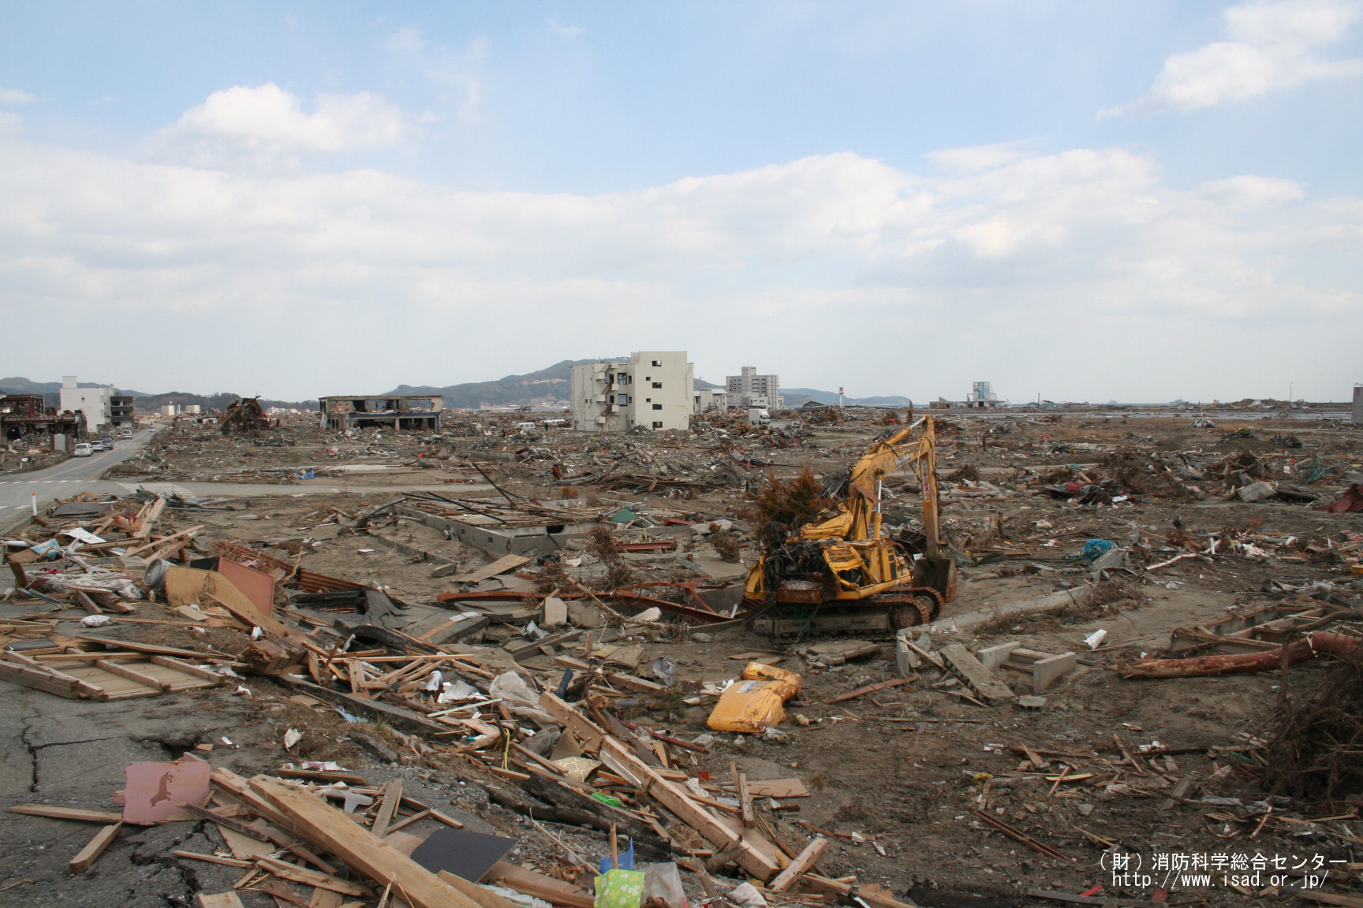
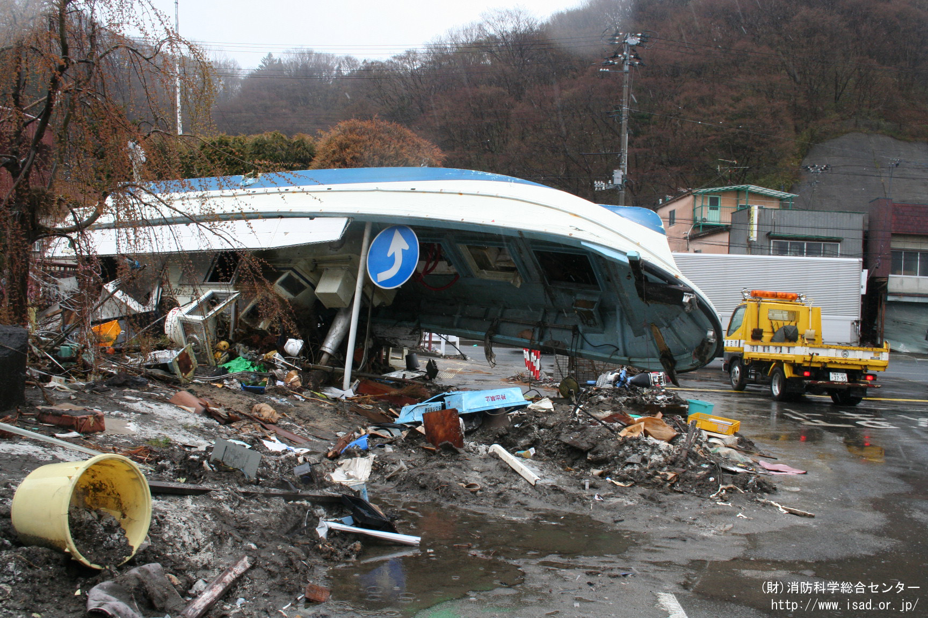
Let’s remember 12 years ago

Slide 2
Preparation for Earthquakes

Slide 3
Two major earthquake
Nankai Trough Mega-Earthquake

